Slide 1
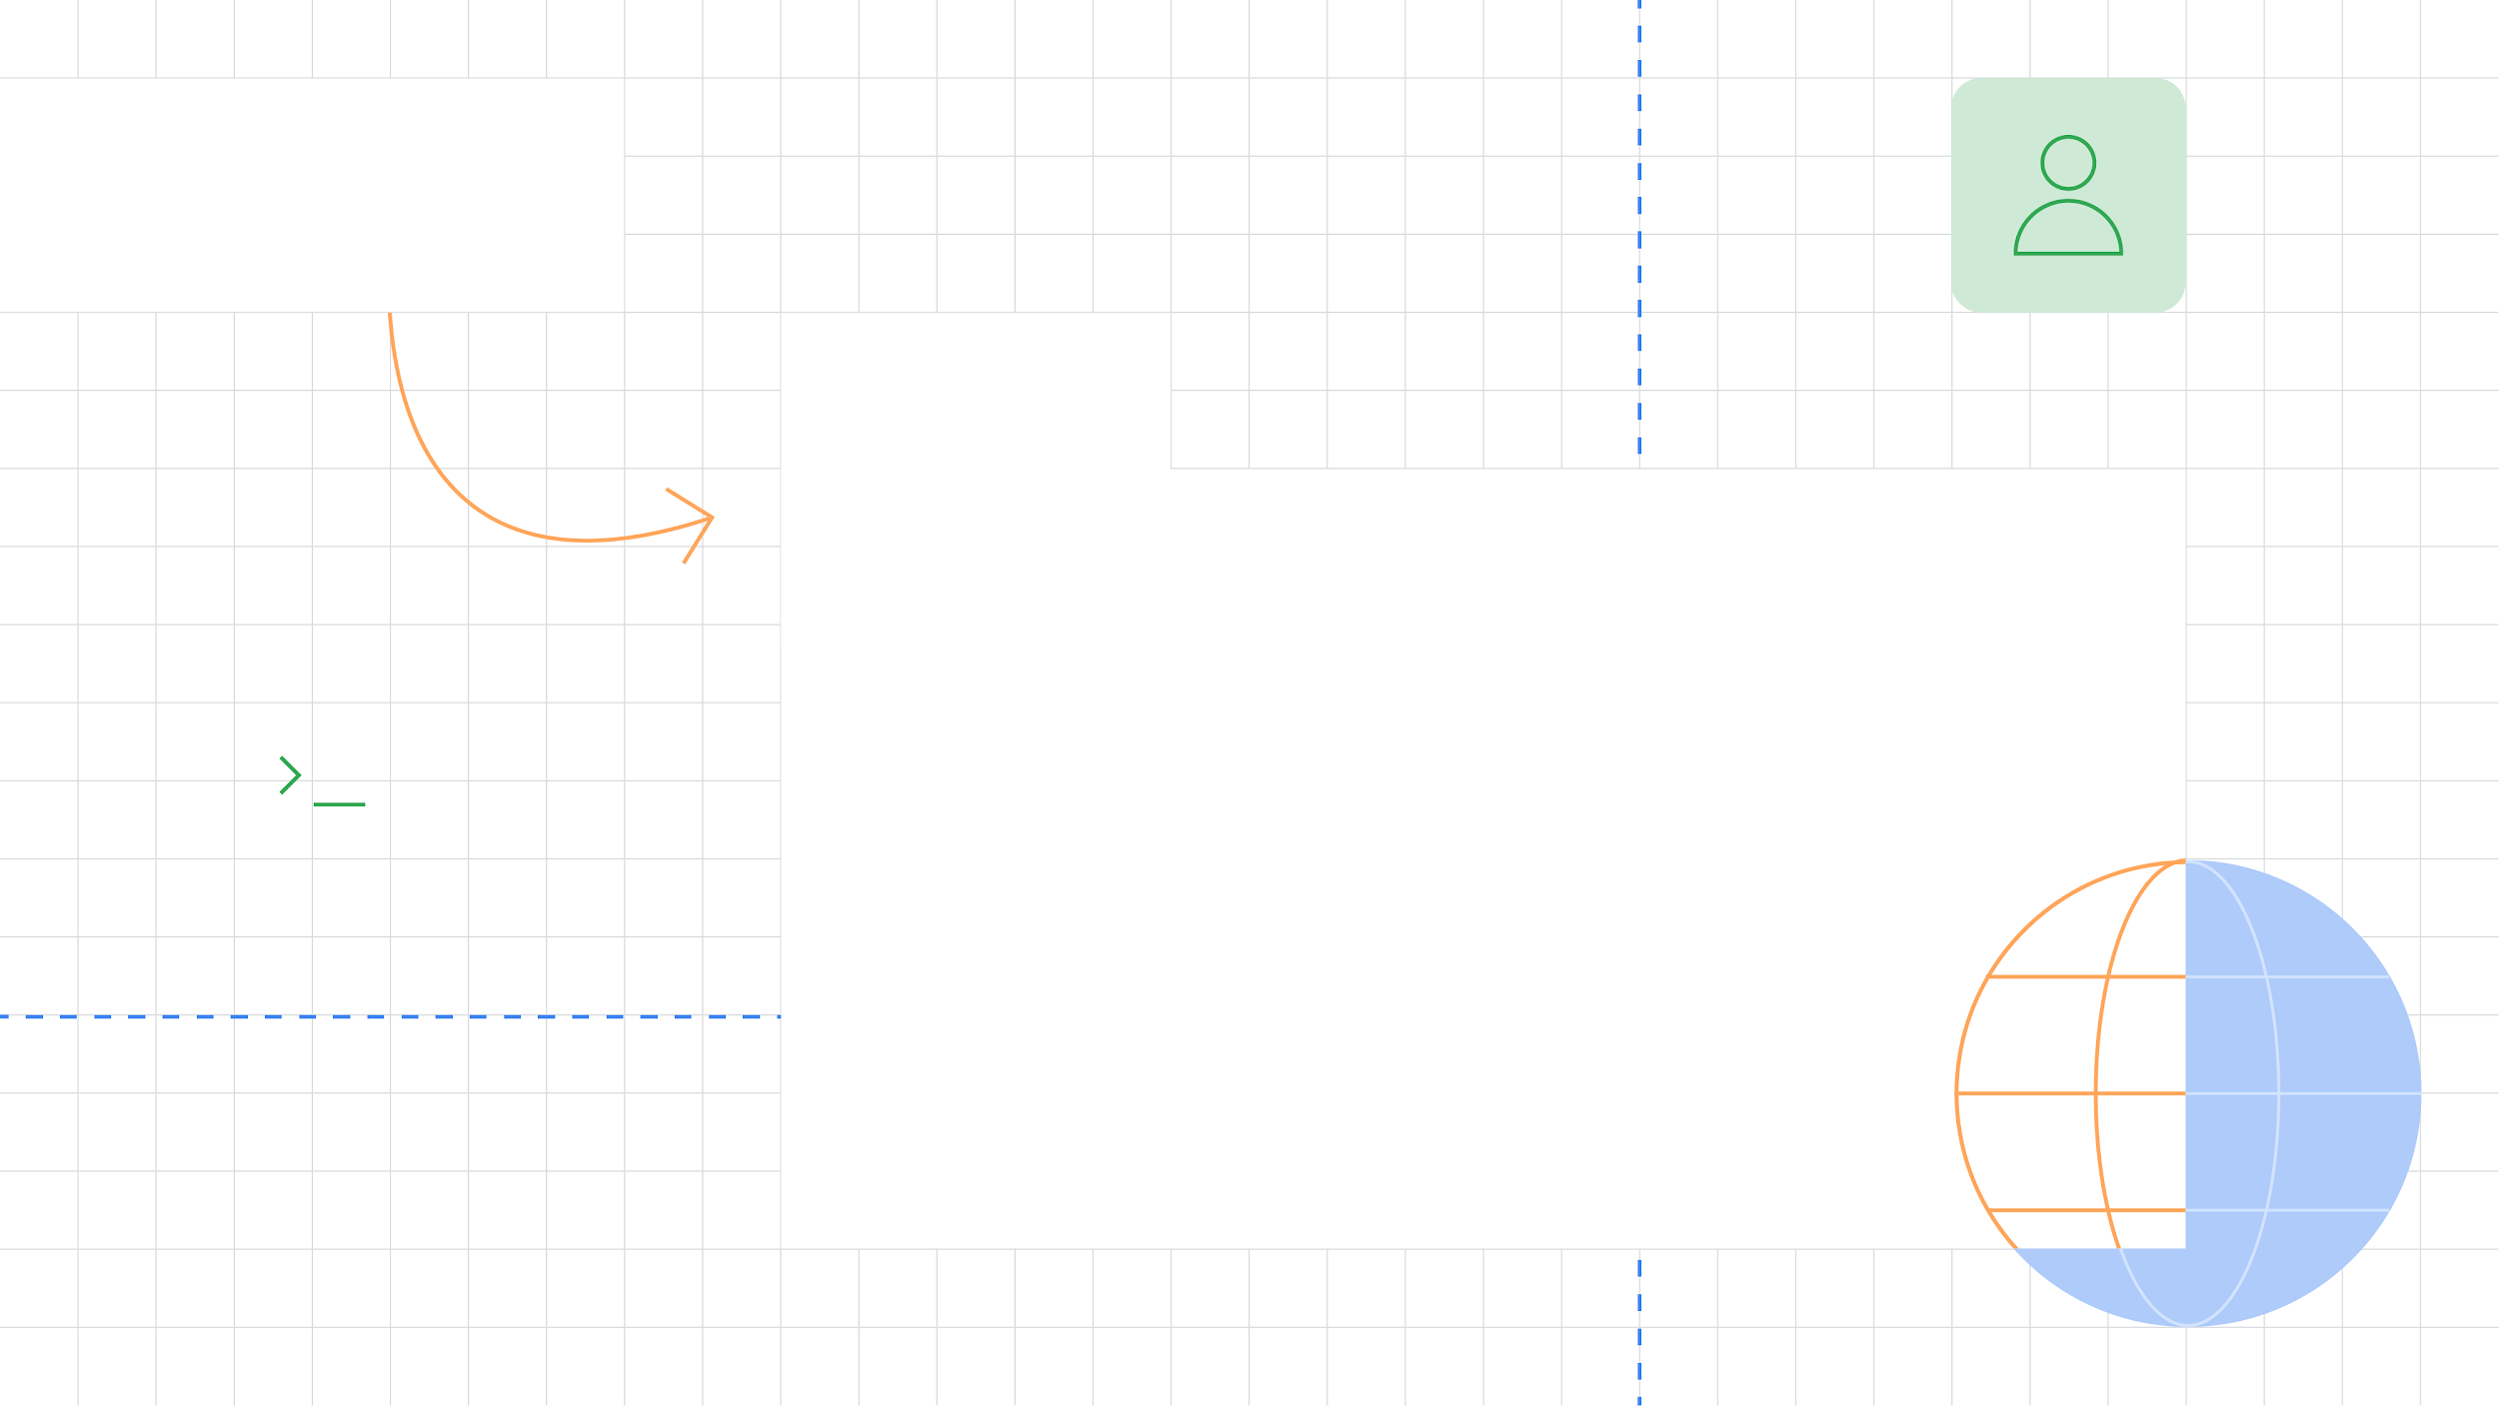

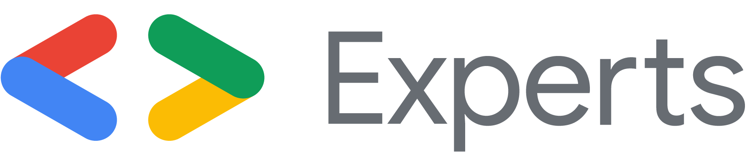

Less is more -
Cross-platform frameworks
in 2020
A look at the ups and downs of cross-platform solutions
Jay (Jeroen Meijer)
Flutter & Dart GDE
@jfkdev

Slide 2


Slide 3
Native app development

Slide 4


Native app development
Pros
Great performance
Good developer support
Easy to give native feel to users
Cons
Separate teams
Expensive
Lengthy
Feature parity can become difficult
Potential loss of a platform

Slide 5
Cross-platform development

Slide 6
Cross-platform development
Pros
Code sharing
One team
Reuse existing knowledge
Cheaper
Faster delivery
Cons (depending on framework)
Performance
Right tool for the job
Lifespan less certain

Slide 7


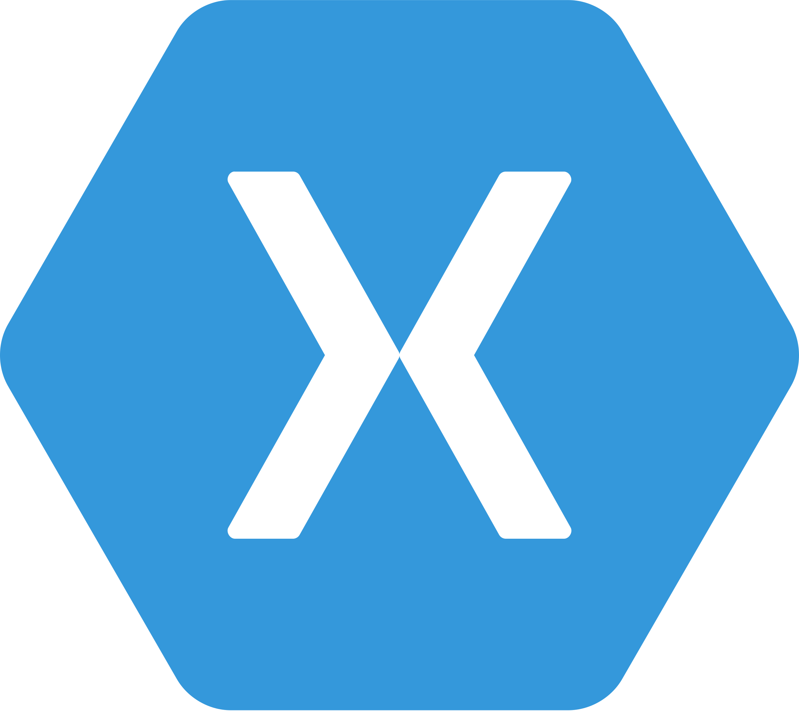
Cross-platform development
React Native
JavaScript
Flutter
Dart
PhoneGap
HTML, CSS, JS
Xamarin
C#

Slide 8
Cross-platform development
What to consider
What do you know already?
Is what’s offered usable?
Is it well-supported and scalable?

Slide 9
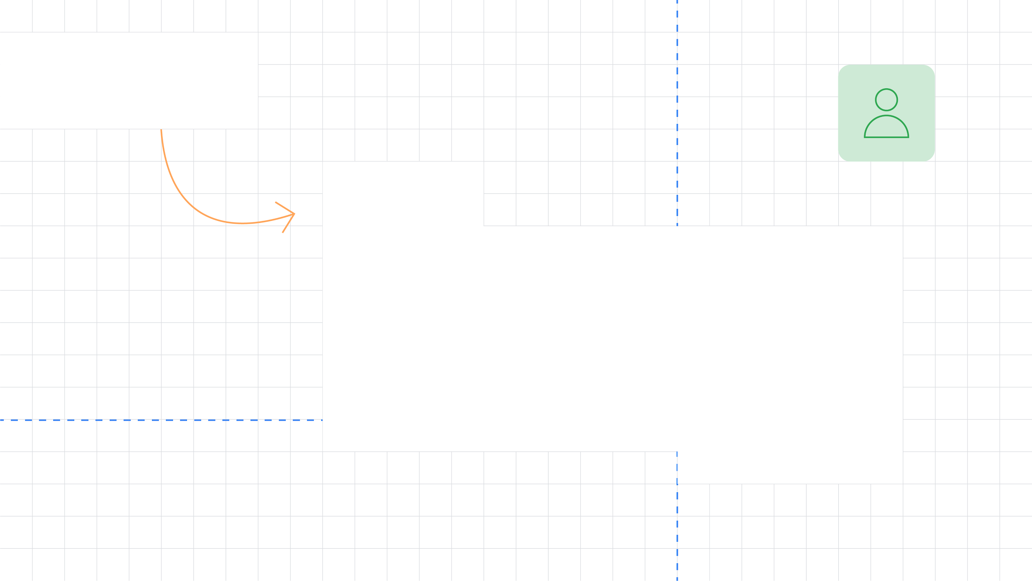
Thank You!
Slides and code available at https://jfk.dev/talks
Jay (Jeroen Meijer)
Flutter & Dart GDE
@jfkdev

